Slide 1
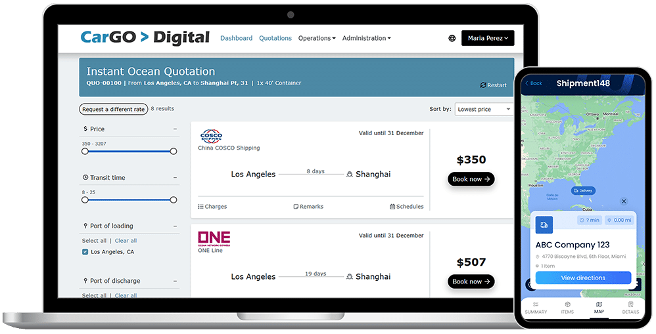
MOVING FREIGHT
FORWARD
The #1 Freight Management Platform for Logistics Service Providers

Slide 2


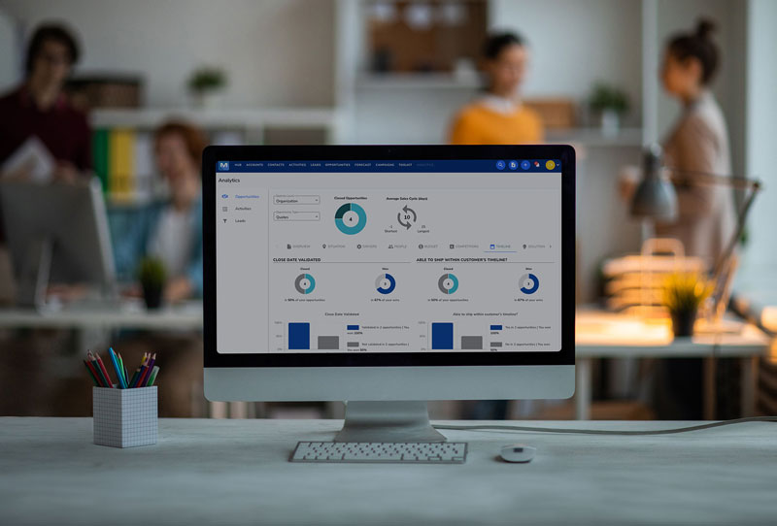



INDUSTRIES WE SERVE
FREIGHT FORWARDING
3PL
NVOCC
WAREHOUSE
COURIER
CUSTOMS BROKERAGE

Slide 3

UNIFIED SHIPPING & WAREHOUSING FOR SEAMLESS OPERATIONS​
Manage freight, warehousing, and distribution in a single platform, eliminating silos and inefficiencies.
MODULAR PLATFORM THAT SCALES WITH YOU​
Start with what you need and expand as your business grows.
​
EASY INTEGRATION WITH ANY THIRD-PARTY SYSTEM​
Connect effortlessly with ERPs, accounting software, e-commerce platforms, and more.​
GLOBAL, BEST-IN-CLASS CUSTOMER SUPPORT​
Wherever you operate, our world-class support team provides fast, expert assistance.
A CULTURE OF INNOVATION, EXCELLENCE, AND SERVICE​
We’re committed to continuous improvement, customer success, and delivering innovative solutions that move freight forward.
THE MAGAYA DIFFERENCE

Slide 4
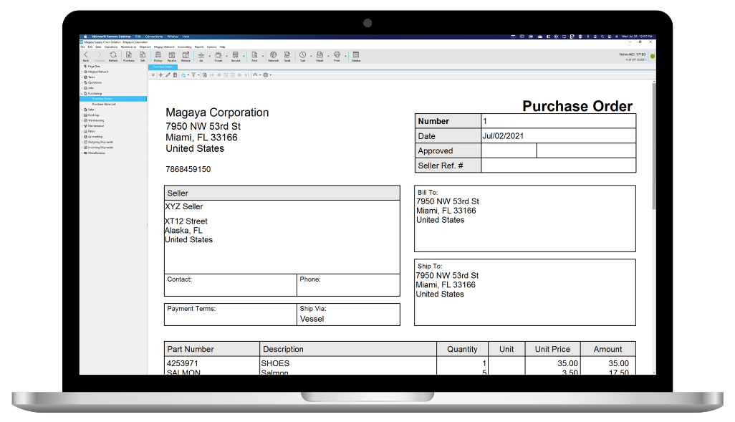
MAGAYA SUPPLY CHAIN Warehouse Ops

Slide 5
MAGAYA SUPPLY CHAIN Warehousing Operations
Optimize warehouse and distribution operations, manage sales orders, track inventory, and oversee the aspects of the supply chain that happen before and after the warehouse.
YOUR BENEFITS
Enable seamless workflows between warehousing and shipping, allowing cargo to be loaded directly to outbound shipments
Optimize your warehouse productivity, enabling you to run a profitable warehouse without the expense of a third-party WMS solution
Easily send tracking numbers and inventory updates to the online sales channel the moment you ship the order
WAREHOUSE RECEIPTS
Process on-hand cargo directly from quotes, bookings, pickup orders or inbound shipments.
Leverage seamless workflows between warehousing and shipping which enables cargo to be loaded directly onto outbound shipment.
SALES ORDER MANAGEMENT
Create Sales Orders from Commerce Quotes.
Manage and create automated allocation rules.
Create pricing rules and minimum price protection.
WAREHOUSE OPERATIONS
Access arrival and location of cargo, SKUs, serial numbers, lot numbers, and multiple stores.
Manage your workday more efficiently with insights into real-time inventory, orders, and more.
SMART WAREHOUSE
Manage inventory by part numbers, serial numbers, lot numbers, expiration dates.
Access inventory queue types supported: FIFO, LIFO, FEFO, LEFO.
Direct the operators to the right locations in the warehouse using pick and put-away sequences.
Operate automatic replenishment with ease, from storage to pick locations.
Manage multiple warehouses in one database.
Manage on-hand cargo directly from quotes, bookings, pickup orders or inbound shipments.
Keep a record of arrival and location of cargo, SKU’s, serial numbers, lot numbers, and expiration date.
Define locations for receiving, storage, quality control, holding area, replenishments, etc.
MAGAYA SUPPLY CHAIN APPS & EXTENSIONS FOR WAREHOUSE MANAGEMENT
FLOW WMS MOBILE APP
Take complete control of your inventory, tasks, receiving and shipping process in real time with the Flow WMS app.
Integrates with Dimensioner to truly optimize the pick and pack process.
PALLET AND PAREL DIMENSIONER
Take fast and efficient measurements of pallets or parcels, regardless of shape, size or material with sophisticated software algorithms.

Slide 6
MAGAYA SUPPLY CHAIN Productivity, Integration & Configuration
Leverage the branding of your business with our flexible options, including document templates and more. Our ecosystem of extensions and apps, coupled with our built-in features, are designed to make your business more productive.
YOUR BENEFITS
Personalize your documents by using our adaptable templates
Leverage complex logic
Choose from a variety of connectivity options, including XML and EDI
JOBS
Combine many transactions of different types into one project with its respective accounting and profitability tracking. Ideal for project cargo in shipping.
TASKS
Create reminders by email or on-screen popups.
Assign tasks to any user in the system.
Visibility into employee time to complete tasks.
MAGAYA NETWORK
Send and receive documentation, transactions, and other data about shipments, through the Magaya Network.
View real-time, up-to-date information about shipments and more.
Create a profile of your company to advertise your services on the Network.
Find and connect with 2300+ agents and logistics companies across 100 countries.
DOCUMENT CONFIGURATION
Access and utilize hundreds of document templates for operations and accounting transaction.
Create and design multipage templates including your terms and conditions.
Fully configure documents and even use JavaScript for more complex logic.

Slide 7
DIMENSIONER BY MAGAYA
Automates a slow, manual process
Captures accurate cargo dimensions with ease, in under 5 seconds
Eliminates upfront costs of traditional measuring tools
Available for pallet, parcel, and high-volume in-motion dimensioning
20%
$40
INCREASE IN REVENUE
EVERY MONTH
ON AVERAGE OF REVENUE
RECOUPED PER PALLET

Slide 8
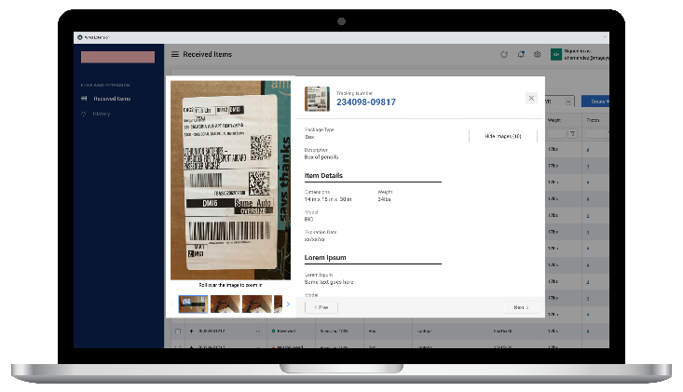
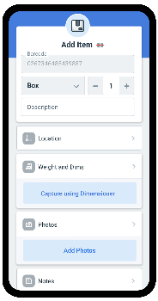
MAGAYA SUPPLY CHAIN APPS & EXTENSIONS
FLOW WMS
BY MAGAYA
Designed for Android™ and iOS™, Flow WMS gives you the freedom of a modern mobile WMS with the real-time visibility and functionality you need for efficient and fast receiving and warehouse operations. With complete control of your warehouse tasks, Flow WMS goes beyond basic warehouse inventory control giving you true productivity in the warehouse.
BENEFITS
INTEGRATED
Flow WMS is designed to work in perfect harmony with Magaya Supply Chain and Magaya Dimensioner, giving you the perfect toolset for your most efficient warehouse ever.
REAL-TIME
Scan barcodes and take photos with the Flow WMS app and attach them in real-time to the related transaction in your Magaya system.
INTUITIVE
Leave clunky old mobile WMS tools in the past, where they belong! Flow WMS has a modern, intuitive interface your users will love, encouraging fast adoption and frequent use.
WORKS WITHOUT WI-FI
Warehouses are notorious for having wi-fi dead zones. Flow WMS keeps you up and running with mobile data - even in the event the wi-fi connection drops.
PHOTO CAPTURE
Document your inventory with photos from the device’s built-in camera. Capture high-quality photos and scan barcodes, then upload them in real-time to the related item or commodity in your Magaya system.
KEY FEATURES
RECEIVING
Blind or by reference
Quick receiving or full details
Scan or manually enter items
Capture photos, print labels, repack
Obtain weights and measures from Dimensioner by Magaya
LOOKUP
Find and edit items by tracking number or location
Take additional photos as needed
Assign new locations
Reprint labels
Obtain weights and measures from Dimensioner by Magaya
View and edit item data
SPECIFICATIONS
In-progress operations saved on the device
Progress can be saved before submitting
Works over wi-fi or mobile data
Compatible with Android (6 and newer) and iPhone (11 and newer)
PICKING & LOADING
Take pictures and edit item information during pick and load
Repack at any time and select package type
Delegate or reassign tasks to other users
Load items directly into a shipping container

Slide 9
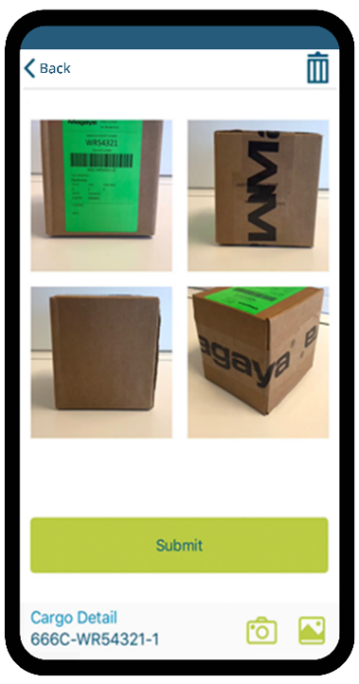
MAGAYA SUPPLY CHAIN APPS & EXTENSIONS
BINDER
BY MAGAYA
The Binder app takes photos of packages or cargo, barcode labels, documents, PDFs, checks, and more, and it then instantly attaches the photos to existing Magaya transactions or commodities in the system. It is often used in the warehouse to take photos of cargo and add them to Warehouse Receipts, Shipments, or other Magaya Supply Chain transactions.
BENEFITS
ADAPTS TO YOUR WORKFLOW
Add images to your Magaya Supply Chain transactions directly from the Binder app. Binder also lets you easily find the transaction or item in Magaya Supply Chain by manually searching or scanning a barcode.
DELIVERS A BETTER CUSTOMER EXPERIENCE
Take pictures of items or documents and send them directly to the right transaction in Magaya, providing the visibility customers want. Pictures are visible to the customer in real-time via the Magaya Digital Freight Portal and LiveTrack Mobile App by Magaya.
SAVES TIME AND MONEY
Save several minutes per item compared to using cameras, cables, memory cards. Plugging camera cables or memory cards is a huge time waster, and sensitive equipment is not made to withstand the warehouse environment.
EASY TO USE
Download the free app to an iOS or Android device and begin uploading photos to the system. There is no setup needed to get started with Binder!
KEY FEATURES
Easy to use on your existing Android or iOS mobile devices.
Take photos or add existing ones that are saved in your phone’s gallery.
Use cellular data or Wi-Fi to upload photos.
Add a Photo to an existing Magaya Transaction.
Add photos to items that you load into a shipment “on-the-fly” Even if the item is not in your Commodity List yet.
“Binder by Magaya has helped us immensely in terms of automating the process of vehicle arrival. We can scan a warehouse receipt and attach all the photos with the Binder app directly into our Magaya system. Before we would have to go through a long process of taking pictures and trying to attach the pictures to the respective transactions. What used to take about 20 minutes now only a couple of minutes with Binder.”
▬
Dmitriy Shibarshin
Marketing Director | West Coast Shipping

Slide 10
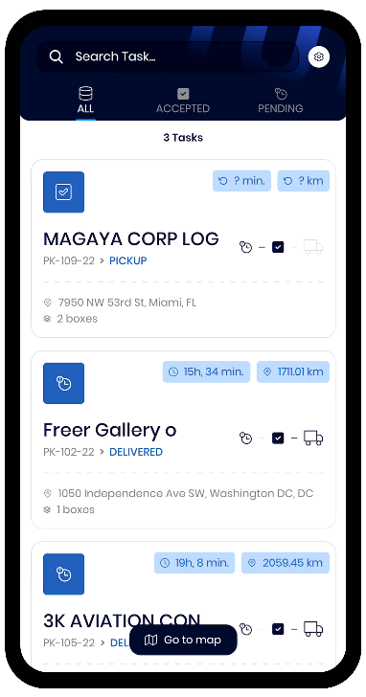
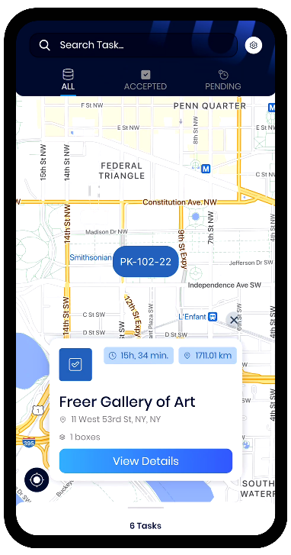

MAGAYA SUPPLY CHAIN APPS & EXTENSIONS
FINAL MILE
BY MAGAYA
The Final Mile app gives drivers an efficient way to pick up and deliver packages and collect signatures, right from their mobile devices. You’ll keep your customers up to date on their delivery status as well as keep your team organized and your Magaya system synced – all from a single app.
BENEFITS
BOOSTS VISIBILITY
Keep customers updated with their pickup and delivery details in real-time, saving you time on customer service calls.
INTEGRATED
Once picked up or delivered, all pertinent data about the delivery is synced back to your Magaya system, automatically.
GO PAPERLESS
Drivers can scan packages and get signatures right on the phone screen, meaning no paperwork to find or carry around.
INCREASES EFFICIENCY
Easily assign tasks to specific drivers or leave them up for grabs. Plus, multiple drivers can use the app to make pickups and deliveries at the same time.
MOBILE COMPATIBILITY
The Final Mile app is free to download on the App Store for iOS or the Google Play Store for Android users.
KEY FEATURES
Use a mobile device or compatible scanner to scan a package barcode
Tasks in Magaya Supply Chain are sent to the app
The app uses the phone’s native maps for turn-by-turn navigation and best route options while on deliveries.
The photo capture feature allows drivers to take photos of packages delivered
Proof of Delivery and photos are visible in the Magaya Digital Freight Portal

Slide 11
Eduardo Bencomo
VP Strategic Accounts
ebencomo@magaya.com

